Slide 1
THE BATTLE OF THE NEIGHBOURHOODS
FINDING CAFES AND PIZERIA IN MAJOR CITIES OF INDIA

Slide 2
INTRODUCTION / BUSINESS PROBLEM
A Startup XYZ in India wants to set up Cafes and Pizzeria in top 10 Major Cities in India. The Startup wants to know the Specific Location in the Major Cities of India where setting up of Cafes or Pizzeria in those cities would profit it. This would also help in getting to know the taste of the people living in those cities. The Startup aims at opening Cafe or Pizzeria depending upon the availability of the Pizzeria or Cafe at that place, is no Cafes or Pizzeria in vicinity, and is closer to the city center.

Slide 3
DATA PROCESSING
Data Acquisition : The Data required for this project is taken from two sources
The first source of data taken from Indian Government website which contains area wise postal codes of India
The second data source is the latitude and longitudes of those postal codes taken from Geonames.org

Slide 4
Data Cleaning : The Data Cleaning Processes are
From first source only Postal Codes, Taluk(Administrative Centers ) and District names are taken
From second source the latitudes and longitudes of respective postal codes are taken
Both the Datasets are merged so as to get the preferred Dataset
Getting the necessary restaurants in the cities according to categories using Foursquare api
Exploring the Cities based on the categories and latitude and longitude

Slide 5
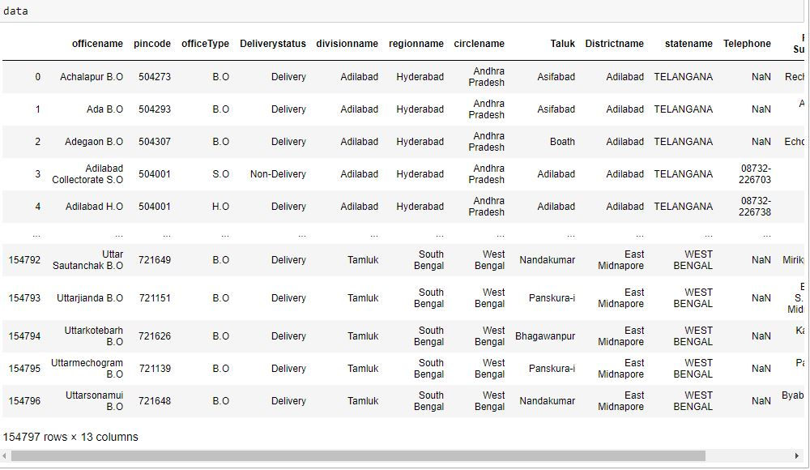
AREA WISE POSTAL CODE DATA
WITH OVER 150 THOUSAND LOCATIONS THIS IS A LARGE DATA SET THAT NEEDS FILTERING

Slide 6
NECESSARY DATA EXTRACTION
1
2
3
REMOVING NULL VALUES OF TALUK
REMOVING DUPLICATE VALUES OF POSTAL CODES
EXTRACTING INFORMATION OF MAJOR CITIES

Slide 7
FOURSQUARE API
4
5
6
GENERATION OF CANDIDATE NEIGHBOURHOODS
GETTING VENUES USING FOURSQUARE API
GENERATION OF MAPS AND HEATMAPS FOR ANALYSIS

Slide 8
METHODOLOGY
IN PREVIOUS STEP WE HAVE COLLECTED THE REQUIRED DATA: LOCATION AND TYPE (CATEGORY) OF EVERY RESTAURANT WITHIN 6KM FROM CITY CENTER. WE HAVE ALSO IDENTIFIED CAFES AND PIZZERIA (ACCORDING TO FOURSQUARE CATEGORIZATION).

Slide 9
NEXT STEP IN OUR ANALYSIS WILL BE CALCULATION AND EXPLORATION OF 'RESTAURANT DENSITY' ACROSS DIFFERENT AREAS OF THOSE CITIES.
IN FINAL STEP WE WILL FOCUS ON MOST PROMISING AREAS AND WITHIN THOSE CREATE CLUSTERS OF LOCATIONS THAT MEET SOME BASIC REQUIREMENTS ESTABLISHED IN DISCUSSION WITH STAKEHOLDERS.

Slide 10
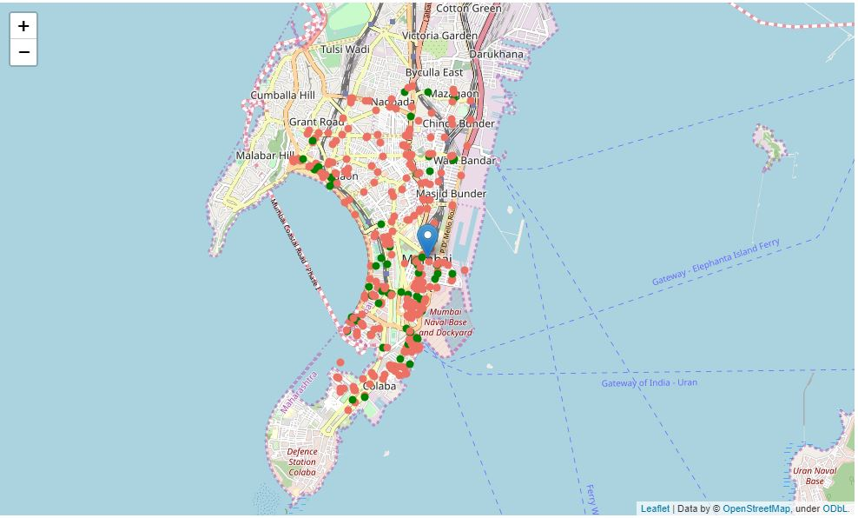
CAFÉ PIZZERIA LOCATIONS
THIS IS A MAP OF MUMBAI SHOWING CAFÉ AND PIZZERIA IN GREEN AND REST IN RED

Slide 11
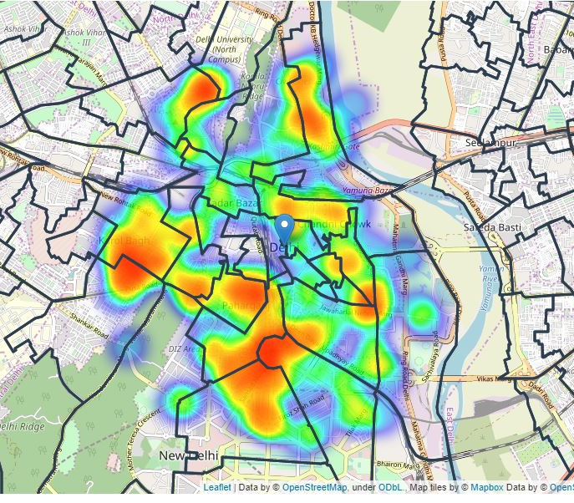
RESTAURANT HEATMAP
THIS IS A MAP OF DELHI SHOWING THE RESTAURANT HEATMAPS

Slide 12
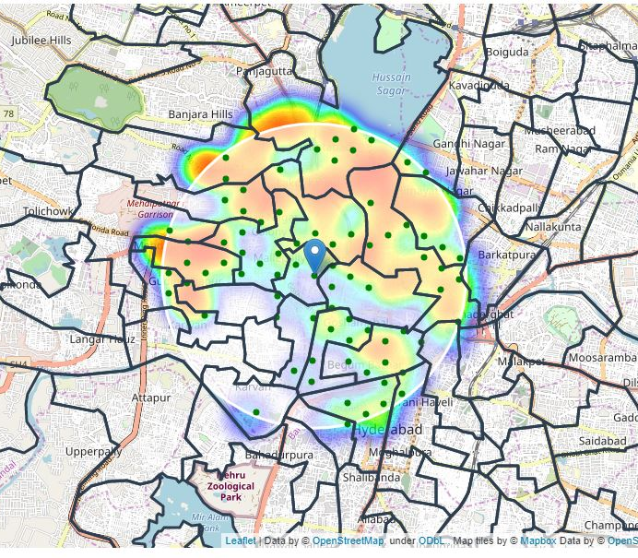
RESTAURANT HEATMAP WITH CAFÉ AND PIZZERIA
THIS IS A MAP OF HYDERABAD SHOWING RESTAURANT HEATMAPS ALONG WITH LOCATION OF CAFÉ AND PIZZERIA IN GREEN POINTS.

Slide 13
KMEANS CLUSTERING
7
8
9
GENRATION OF KMEANS MODEL
FITTING OF DATA AND PREDICTION OF CLUSTERS CENTERS
VISUALIZING CLUSTER CENTERS ONTO MAPS

Slide 14
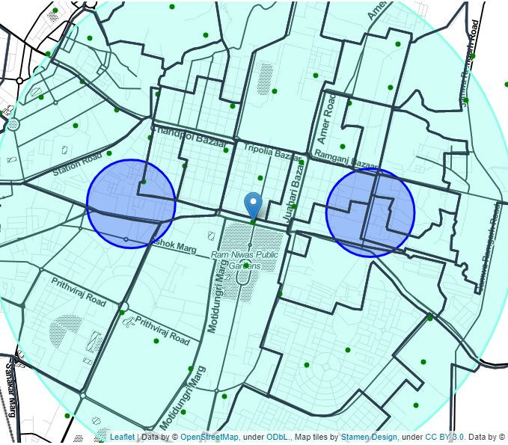
CLUSTER CENTER MAP
THIS IS A MAP OF JAIPUR SHOWING CLUSTER CENTERS IN BLUE CIRCLES

Slide 15
RESULT AND DISCUSSION
OUR ANALYSIS SHOWED US THE AREAS SUITABLE FOR SETTING UP OF CAFÉ AND PIZZERIA. THIS ANALYSIS CAN ALSO HELP OTHER START-UPS ALSO. THEY CAN CHOOSE EITHER TO SETUP CAFÉ AND PIZZERIA OR ANY OTHER TYPE OF VENUE ALSO.

Slide 16
CONCLUSION
PURPOSE OF THIS PROJECT WAS TO IDENTIFY AREAS CLOSE TO CITY CENTER WITH LOW NUMBER OF RESTAURANTS (PARTICULARLY CAFES & PIZZERIA) IN ORDER TO AID STAKEHOLDERS IN NARROWING DOWN THE SEARCH FOR OPTIMAL LOCATION FOR A NEW CAFE OR PIZZERIA RESTAURANT.

